Slide 1
Teacher Leadership Councils (TLCs)
Onslow County Schools
Secondary Math

Slide 2
Teacher Voice

Slide 3
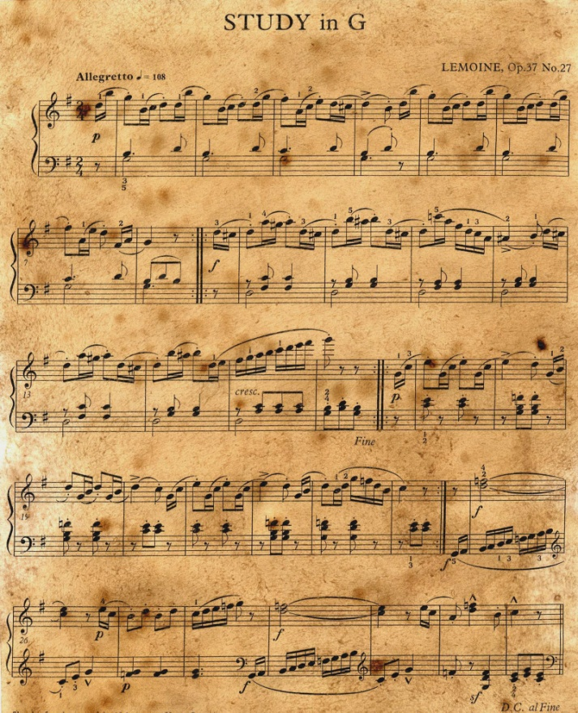
Same Sheet of Music
High School Math
Math I, II, III
Fourth Math (http://www.ncpublicschools.org/docs/academicservices/2013/math-options-chart.pdf)
Completion Charts
What does this mean for us and for students?
Notes:
May want to insert the math slides from the teacher update and take copies of the graduation charts

Slide 4
HS Math Course Update
For Information Sharing and Clarification

Slide 5
High School Math Update
September 30, 2013 *with teachers October 4, 2013
**shared with Secondary Math TLC October 24, 2013

Slide 6
Course Implementation Timeline
Fall 2013 | Spring 2014 | 2014-2015 and Beyond
Math I (2103) | Math I (2103) | Math I (2103)
Math II (2201) | Math II (2201) | Math II (2201)
 | Math III (2301) *rare cases where students take Math II first semester and double up second semester | Math III (2301)
Common Core Geometry (2030)
Common Core Algebra II (2024) | Common Core Algebra II (2024)
Foundations Courses are Electives Foundations Math I (2050) Foundations Math II (2051) Foundations Math III (2052)
Fourth Math Courses remain the same for 2013-14.

Slide 7
Math I (2103)
Who? All students taking first math 2012-2013 (last year) and beyond
Assessment End of Course Test for Math I

Slide 8
Math II (2201)
Who? All students who took their first math in 2012-2013 or after regardless if it was Algebra I, Common Core Algebra I, or Math I. [All Freshmen and Sophomores]
A revised Standard Division Document will be created this week with teacher input.
Assessment North Carolina Final Exam for Math II

Slide 9
Common Core Geometry (2200)
Who? Students who will also complete Common Core Algebra II this year.
Note: Common Core Geometry follows the existing sequence based on the current Standard Division Documents (SDDs). *This course is only available this year. A student in CC Geometry will need to complete the sequence with CC Algebra II during this school year.
Assessment NC Final Exam for Common Core Geometry

Slide 10
Math III (2301)
Who? Students completing a math sequence where they have taken Math I and Math II
Note: Math III will likely not be needed this school year. This year’s students would be completing the existing sequence based on the current Standard Division Documents (SDDs). A revised SDD will be prepared this week for Math III.
Assessment 2013-2014 North Carolina Final Exam 2014 → Smarter Balanced?

Slide 11
Common Core Algebra II (2300)
Who? Students who have completed Common Core Geometry (2200) or previous Geometry course.
Note: Common Core Algebra II follows the existing sequence based on the current Standard Division Documents (SDDs). *This course is only available this year. A student in CC Algebra II will need to complete the sequence this school year (or they will have to be enrolled in a Math III course next year).
Assessment NC Final Exam for Common Core Algebra II

Slide 12
References/Resources
NC DPI Math WikiSpace http://maccss.ncdpi.wikispaces.net/High+School
Math I, II, III Brochure http://maccss.ncdpi.wikispaces.net/file/view/Math%20I%2C%20II%2C%20III%20Brochure.pdf/450355826/Math%20I%2C%20II%2C%20III%20Brochure.pdf
Math I, II, III Sequence (Quick View) http://maccss.ncdpi.wikispaces.net/Course+Sequence+Options

Slide 13
References/Resources
Major Work of Math I, II, III http://maccss.ncdpi.wikispaces.net/Major+Work+of+High+School
FAQs High School Math http://maccss.ncdpi.wikispaces.net/High+School+FAQ+Documents
High School Math Webinar http://maccss.ncdpi.wikispaces.net/High+School+Webinars

Slide 14
Notes
All students in a first math course this year need to enrolled in Math I (2103)
The SDD for this course is correct, with one additional standard to be added (G-GPE.6)
Math III will most likely not need to be offered until 2014-15 (unless a school switches to Math II first semester and doubles up those kids to Math III second semester).
Common Core Geometry and Algebra II (the course based on our current SDDs) will not be available after this year (2013-14).

Slide 15
Standard Division Documents
October
How we got here and what next?
November
Deep Dive Into Standards and SDD Review
December
Deep Dive Into Standards and SDD Review
January
February
Mid Point Check In and SDD Revision
Deep Dive Into Standards and SDD Review
March
April
Final Revisions of SDD and Sharing with School Based Teams
Final Draft Ready for Publishing

Slide 16
Setting Goals for 2013-14
Notes:
Being strategic and measureable this year
What makes a successful TLC

Slide 17
Decision & School Net
Log In to Home Base
(https://onslow.powerschool.com/admin)
Options
TLC Feedback and Choice
Notes:
Need to remember Home Base
SchoolSchool Net Overview
o Reiterate and Discuss that their input will help OCS decide if we should invest in School Net
I will need to login to PowerSchool-not sure if

Slide 18
Home Base
http://www.ncpublicschools.org/homebase/
Notes:
Home Base is PowerSchool + True North Logic (Evaluation) + Optional IIS (School Net, Open Class, Test Nav)

Slide 19
IIS / School Net
http://www.ncpublicschools.org/homebase/
Notes:
The IIS (Integrated Instructional System) (Instructional Improvement System) is an opt-in decision which has a cost of $4 per student and we will need the opinions of TLC members, admins, district, etc to decide if this is a good decision
So, let’s look at the elements (the middle of this diagram)

Slide 20
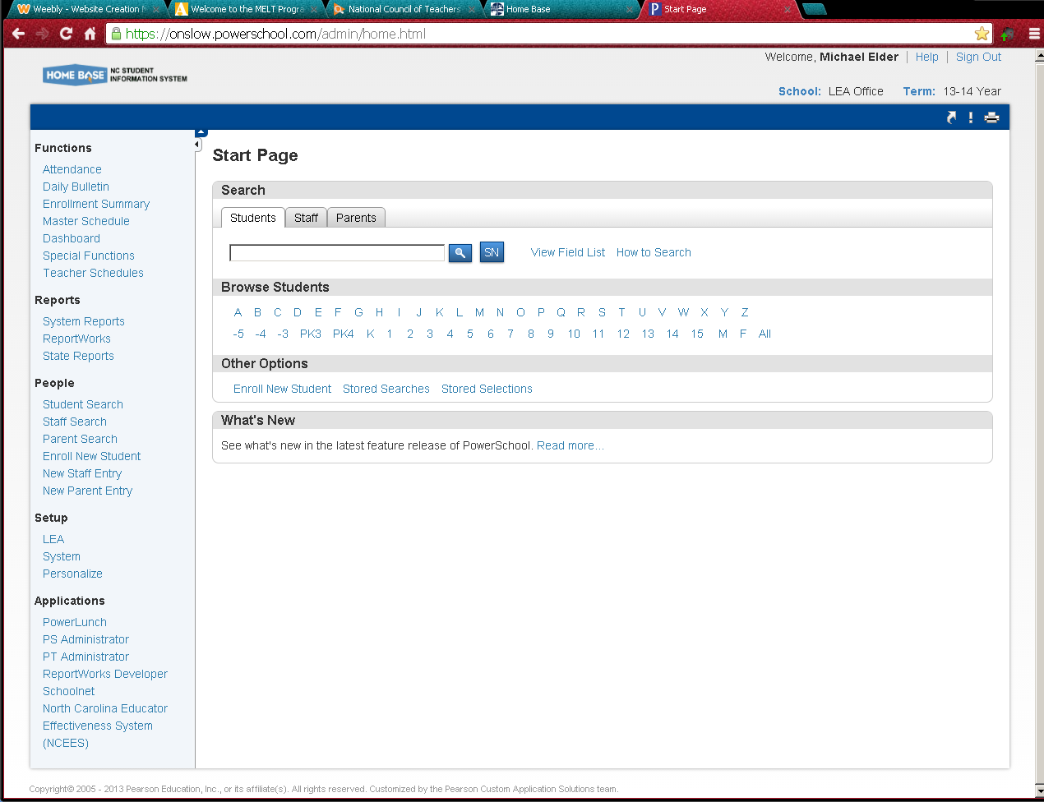

Slide 21
IIS in Home Base

Slide 22
Searching Materials

Slide 23
Assessment Admin Tab

Slide 24
Create an Assessment Test Central

Slide 25
Item Central Creating Items

Slide 26
Open Class
Learning Management System (LMS)
Similar to Blackboard
Similar Edmodo
Could set up online classes or blended learning
http://www.openclass.com/home Video (2 minutes)
http://www.ncpublicschools.org/homebase/

Slide 27
Test Nav
Test Item Creator/Test Generator
Items from ClassScape
Can create your own items
Classroom Testing
Benchmark Testing
Exports to PowerSchool Gradebook
http://www.ncpublicschools.org/homebase/

Slide 28
SchoolNet
Unit Planning
Lesson Planning
Resources
Yours
Schools
District
State Shared
http://www.ncpublicschools.org/homebase/

Slide 29
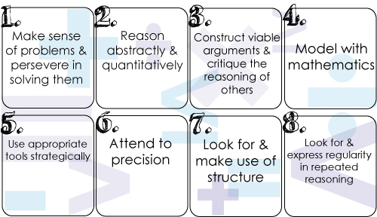
Deep Dive
Notes:
Deep Dive as a way to explore standards or units with teachers at your school
May want to provide flip books
Reminder of Unpacking Documents
Choose one standard within the SDD and do Deep Dive activity (for their benefit and so they can take it back for their teachers at their school)

Slide 30
Credit by Demonstrated Mastery (product oriented)
Analysis of Student Work (ASW)

Slide 31
Resource Sharing
NC DPI Math Wiki http://maccss.ncdpi.wikispaces.net/
Problems with a Point http://www2.edc.org/MathProblems/
Learn Zillion www.learnzillion.com
Flex Books www.ck12.org
Flip Books for Common Core http://katm.org/wp/common-core/

Slide 32
Math Progressions http://commoncoretools.me/category/progressions/
Mathematics Assessment Resource Service (MARS) http://map.mathshell.org/materials/lessons.php
Quantiles (advancement/remediation) http://www.quantiles.com/

Slide 33
Teacher Leadership Councils (TLCs)
Upcoming Sessions (JHS 3:00-5:00pm)
Thursday, November 21
December/January Electronic
February 20
March Electronic
April 24
May/June Electronic

