Slide 1
Secondary Math Update
While we are waiting to start…
When you are looking at the SDD for Algebra I (high) – when is F.IF.7a taught based on SDD?
(Graph linear and quadratic functions and show intercepts, maxima, and minima.)
Tuesday, November 13, 2012
Michael Elder & Math Leaders

Slide 2
Agenda - Goals
Develop a Common Understanding of…
Math Expectations
Math Standards
Assessment for 2012-2013 and beyond
Location of Resources
Visioning
Gather Questions

Slide 3
A Little Relief
http://vimeo.com/14975413

Slide 4
Math Expectations
Math Practices
Math Standards
Non-Negotiables
How we will teach to address these:
What every elementary student will enter middle school knowing:
What every middle school student will enter middle school knowing:
What every high school student will enter a university or career knowing:

Slide 5
Math Practices
The How behind the Content
From: http://www.insidemathematics.org/index.php/commmon-core-math-intro

Slide 6
Math Practices→ Details
Unpacking Documents From: http://maccss.ncdpi.wikispaces.net/home

Slide 7
Math Standards
Which Standards?
6th-8th Grade: Common Core Standards Attention to Gaps due to transition
Algebra I: Math I Standards (8th Grade, 9th Grade, 10th Grade…)
Geometry: Common Core Standards Attention to Gaps due to transition
Algebra II: Common Core Standards Attention to Gaps due to transition
Fourth Math (AFM, Pre-Calculus, etc.): 2003 Standard Course of Study for this year

Slide 8
Math Standards: Major Work of the Grade
Major Work of the Grade- clarification http://maccss.ncdpi.wikispaces.net/NCCTM

Slide 9
6th Grade Wordle

Slide 10
7th Grade Wordle

Slide 11
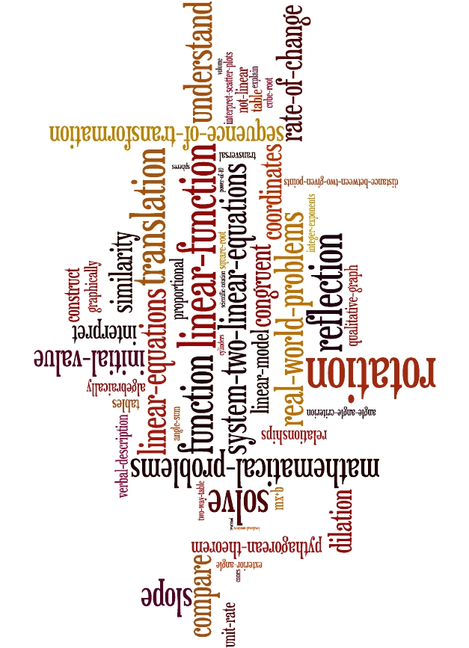
8th Grade Wordle

Slide 12
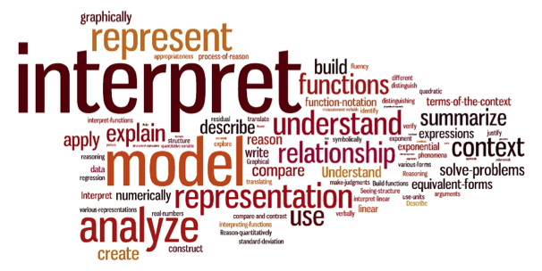
Math I Wordle

Slide 13
Summative Assessments in Mathematics
Measures of Student Learning (MSL) / Common Exams
End of Grade/Course Summative Assessments
6th Grade Math
7th Grade Math
8th Grade Math
Algebra I (based on new standards)
Geometry (locally generated first semester)*
Algebra II (locally generated first semester)*
AFM (state generated)
*Teams to create the Geometry and Algebra II Common Exams will be pulled together soon.

Slide 14
Content Specifications
Sixth, Seventh, Eighth Grade, and Algebra I
Test Specifications http://www.ncpublicschools.org/docs/acre/assessment/math.pdf
Link to content and to one or more math practices

Slide 15
Weight Distributions

Slide 16
Details on CCSS Summative Exams
Grades 5–8 & Algebra I Math assessments
Four-response-option multiple-choice items and
About 20% gridded-response items requiring numerical responses
NCEXTEND2 assessments
three-response-option multiple-choice items and gridded-response
Calculator-active and inactive sections
1/3 to ½ of the Grades 3–8 assessments inactive
1/3 Algebra I will be calculator inactive.
NCEXTEND1 mathematics
15 performance-based, multiple-choice items

Slide 17
Number of Questions
How many questions of each type will there be (EOG)?
Grades 3–5: For the general assessments, there are a total of 54 questions, of which 10 are experimental.
Grades 3–5: For the NCEXTEND2 assessments, there are a total of 48 questions, of which 8 are experimental.
Grades 6–8: For the general assessments, there are a total of 60 questions, of which 10 are experimental.
Grades 6–8: For the NCEXTEND2 assessments for grades 6–8, there are a total of 50 questions, of which 10 are experimental.

Slide 18
Released Forms
2012-2013 Released Forms
Available now for Algebra I http://www.ncpublicschools.org/accountability/testing/releasedforms In online and paper-pencil format
Available after January for elementary and middle grades math

Slide 19
Common Exams
Aligned to new Common Core Standards
Only one version of the Common Exam/MSL
Common Exam/MSLs are calculator active.
No released forms
Assessment prototypes for examples http://www.ncpublicschools.org/docs/educatoreffect/measures/sample-high-exam.pdf
Jennifer Preston with the NC Department of Public Instruction helped with this information.

Slide 20
Pre-Calculus and AFM Common Exam Specifications
http://www.ncpublicschools.org/docs/educatoreffect/measures/specifications/pre-calculus.pdf

Slide 21
Proficiency Levels
Grades 3-8 Mathematics http://www.ncpublicschools.org/docs/accountability/testing/achievelevels/g38mathalds.pdf

Slide 22
Timeline Reminder
EOG/EOCs

Slide 23
Resources
NC DPI WikiSpace: www.maccss.ncdpi.wikispaces.net
Symbaloo(s): www.symbaloo.com
K-8 Quick Reference Guides: http://aplus.ncdpi.wikispaces.net/Reference+Guides
Lessons for Learning (Middle School Lessons/Units)
http://maccss.ncdpi.wikispaces.net/Lessons+For+Learning
One Another & TLC Work
Onslow County Schools Website
Rubicon Atlas

Slide 24
Visioning
How will math instruction look different as a result of our work…
Next week?
In one year?
In five years?

Slide 25
Questions and To-Dos
Questions and To-Dos that emerged
What kind of score will teachers see from EOGs/EOCs and Common Exams?
Need to look at timing and pacing of SDD and Benchmark exam as well as the percent of inactive items (should it align with state test specifications)
For Statistics will there be a state exam or a locally developed Common Exam (or will these just be teacher made final exams)

Slide 26
Questions and To-Dos continued
Will Gridded Response items on an Algebra I EOC done online just be typing in the response?
Does “Constructed Response” include gridded response?
What kind of training will there be for scoring using the state rubric for constructed response?
Can constructed response items be completed before the day of the exam?
Make sure all teachers are using the Common Core State Standards and know where to find their unpacking documents
Share, share, and share
Follow the Onslow Math Blog for immediate updates (www.onslowmath.blogspot.com)

Slide 27
Questions and To-Dos continued
Teachers in the group asked if we could have an Edmodo group for Secondary Math to share
Set Friday, November 30th as a date to pull teachers to create local Common Exams (MSLs) for Geometry and Algebra II
Suggestion to have 4 teachers for Algebra II and 4 teachers for Geometry
At least one from each HS if possible
Will set the date and get back to everyone ASAP
TLC groups- suggestion to work on sample plans and to do some training on Big Ideas, Enduring Understandings, etc.

Slide 28
Questions and To-Dos continued
Make sure all teachers are using the Common Core State Standards and know where to find their unpacking documents
Share, share, and share
Follow the Onslow Math Blog for immediate updates (www.onslowmath.blogspot.com)

