Slide 1
Reading in the Elementary Math Classroom
Scaling Everest
Tools for Climbing the Reading Mountain
Common Core & Essential Standards Institute
July 31-August 2, 2012

Slide 2
Come Together…
Join Me
Can’t see the projector?
Don’t have a projector?
Just don’t like the projector?
Have kids that want to share with the class or across small groups?
Go to www.join.me/____ (enter the code here)
A tool if you do not have a projector
Great for 1:1 classrooms
Can switch control
Could be a student presenter as well
Share your thoughts and resources at
www.todaysmeet.com/mathreading

Slide 3
K-5 Math Vocabulary

Slide 4
Remembering
What do you remember?
After you read, what do you remember?
Why do you remember what you remember?
How do we translate this to kids?
What do you forget?
After your read, what do you tend to forget?
Is this good, bad, or does it depend?
Why do you forget what you forget?
How do we translate this to kids?
Remember to share at www.todaysmeet.com/mathreading

Slide 6
Characteristics (adapted from Minton, 2007 in Sammons, 2011)
Good Readers
Good Mathematicians
Call upon prior knowledge to make meaning
Fluent
Create mental images of what they read
Use multiple strategies to understand/interpret text
Monitor understanding as they read
Can clearly explain their interpretation to others
Call upon prior knowledge to understand concepts and solve problems
Procedurally fluent
Create multiple representations of concepts and problems
Use multiple strategies to understand concepts and problems
Monitor understanding
Can clearly explain their mathematical thinking to others
Remember to share at www.todaysmeet.com/mathreading

Slide 7
Remember to share at www.todaysmeet.com/mathreading

Slide 8
Finding Text Resources
Books by Strand
Math Book Presentation
Remember to share at www.todaysmeet.com/mathreading

Slide 10
Do Students Need to Read Math?
Sample Lesson: Patterns of Change
Core-Plus Mathematics (9th-10th Grade)
What do we notice
Remember to share at www.todaysmeet.com/mathreading

Slide 12
Vocabulary
Let’s Play a Bit (medical terms activity)
How do we learn vocabulary?
Brainstrom
Developing Vocabulary Maps
http://www.sanchezclass.com/reading-graphic-organizers.htm (which of these apply to math activity)
http://www.scholastic.com/teachers/lesson-plan/graphic-organizers-reading-comprehension
http://www.bigthought.org/Portals/BT/2011TM_SummerCurriculum/1st/excellent-book-of-graphic-organizers.pdf (PDF)
Vocabulary in Math Classroom Voice Thread
http://voicethread.com/?#q.b3191567
Remember to share at www.todaysmeet.com/mathreading

Slide 13
Building a Concept
Building a Semantic Map
Frayer
Semantic Map
Others
What do I have to know to understand a term like “Square number,” “Square,” “Three-Dimensional,” etc.
Remember to share at www.todaysmeet.com/mathreading

Slide 14
Frayer Model

Slide 15
Frayer Model Example

Slide 16
Rating Vocabulary

Slide 17
Definition Map

Slide 18
One Sentence Summary (Literacy---how could it be math?)

Slide 19
Three Word Response

Slide 20
Word Wall Student Work

Slide 21
Idea Web http://printables.scholastic.com/printables/f.jsp?id=35517

Slide 22
Sequencing and Flow Charts

Slide 23
if yuo can raed tihs, you hvae a sgtrane mnid, too. Can you raed tihs? Olny 55 plepoe out of 100 can. i cdnuolt blveiee taht I cluod aulaclty uesdnatnrd waht I was rdanieg. The phaonmneal pweor of the hmuan mnid, aoccdrnig to a rscheearch at Cmabrigde Uinervtisy, it dseno't mtaetr in waht oerdr the ltteres in a wrod are, the olny iproamtnt tihng is taht the frsit and lsat ltteer be in the rghit pclae. The rset can be a taotl mses and you can sitll raed it whotuit a pboerlm. Tihs is bcuseae the huamn mnid deos not raed ervey lteter by istlef, but the wrod as a wlohe. Azanmig huh? yaeh and I awlyas tghuhot slpeling was ipmorantt! if you can raed tihs forwrad it.

Slide 25
Instructional Strategies
Instructional Strategies for Reading
How do these apply to mathematics?
http://olc.spsd.sk.ca/de/pd/instr/alpha.html (alphabetized)
http://www.literacy.uconn.edu/compre.htm
Remember to share at www.todaysmeet.com/mathreading

Slide 27
Power of Exposure Over Time
Will U B in Mr. Ss Class?
AFAIK
PCM
K BZ TTYL
K
H2CUS
J4F RU Going OVR 2 SCH 2DA?
☹
Remember to share at www.todaysmeet.com/mathreading

Slide 29
Reading in a Variety of Mediums
Remember to share at www.todaysmeet.com/mathreading

Slide 31
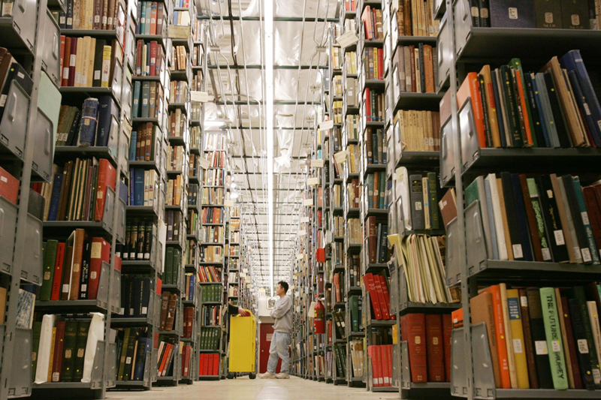

Slide 32
NCTM
www.nctm.org
Resources http://www.nctm.org/resources/default.aspx?id=230
Remember to share at www.todaysmeet.com/mathreading

Slide 34
Remember to share at www.todaysmeet.com/mathreading

Slide 35
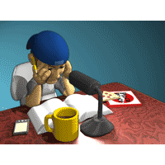

Slide 36
Remember to share at www.todaysmeet.com/mathreading

Slide 38
Summiting Everest
Math Proficiency and Reading Proficiency
True Reading Disability Issues
Where are they completely co-mingled?
Can a student be mathematically proficient and struggle with reading?
Remember to share at www.todaysmeet.com/mathreading

Slide 40
Remember to share at www.todaysmeet.com/mathreading

Slide 41
Contact Information
Michael Elder, Coordinator Academic Innovation
Michael.elder@onslow.k12.nc.us
(910) 455-2211 ext. 20264
www.mathunpacking.weebly.com
Symbaloo username: Mulligan130
Shelly Alford
Michelle.alford@onslow.k12.nc.us
Remember to share at www.todaysmeet.com/mathreading

