Slide 1


Packing Tuesdays
Packing the Common Core
and Essential Standards
Tuesday, March 5, 2013
Hunters Creek Middle School
Michael Elder, Director Academic Innovation

Slide 2
Room Assignments
Subject Area | Room
K-5 English Language Arts | 105
6-8 and 9-12 English Language Arts | 107
K-12 Social Studies | 103
K-8 Science | 101
9-12 Science | 111
K-5 Math | 109
6-12 Math | 110
K-12 Fine Arts | 108
K-12 Health/PE | 112

Slide 3

http://maccss.ncdpi.wikispaces.net/Summer+Institute+2012+6+-+12

Slide 4
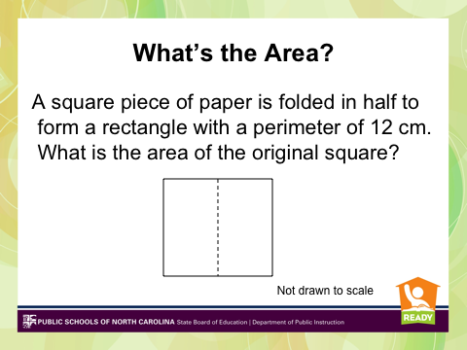
http://maccss.ncdpi.wikispaces.net/Summer+Institute+2012+6+-+12

Slide 5
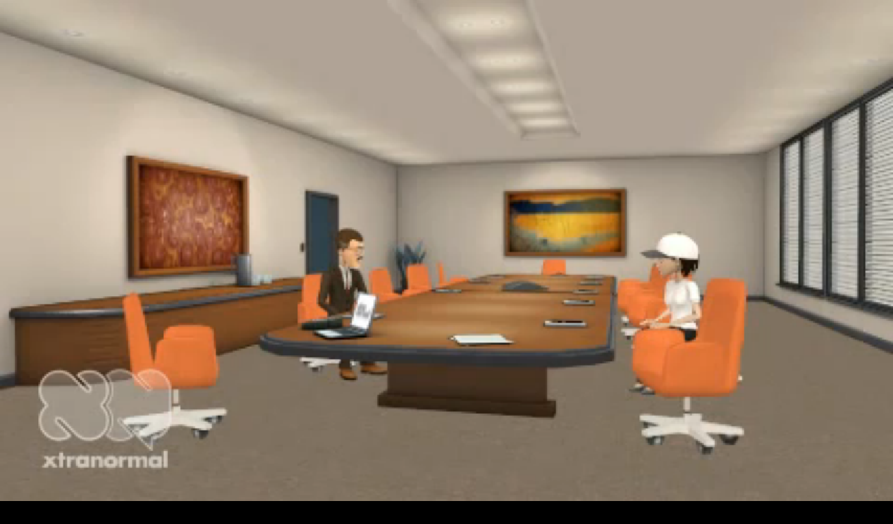
Getting Started: I Choose “C”

Slide 6
Where are We Going?
Develop a deeper understanding of the Common Core and Essential Standards.
Examine and develop performance tasks based on the new standards.
Explore resources to support CC & ES Curriculum, Instruction, & Assessment planning and implementation.
Examine the elements of CIA planning and how they relate to the CC & ES
Deepen understanding of conceptual planning;
integrating the standards through CIA Planning

Slide 7
Where are We Going?
Outline for Packing Tuesdays
Session 1 – Standards and Performance Tasks by content areas.
Session 2 – Resources and Strategies by content areas.
Session 3 – Elements of CIA planning and the Standards
Session 4 – CIA Planning: putting it all together & integrating the standards.

Slide 8
Today’s Leg of the Journey
Ensure we know where our “primary resources” are located
Address Burning Issues
Participate in an activity or two
Look at our long term itinerary
Gather information about how we can support you as you plan conceptually.

Slide 9
Traveling Alerts
  Group Discussion / Questions
  Before we travel let’s make sure there are no advisories…
  What are the Hot Topics or Burning Issues that we can either answer today or get you answers about?
Notes:
When planning a trip, we typically look ahead, check the weather conditions, and then begin packing for our trip. So, let’s take a look at our current traveling conditions.

Slide 10
Traveling Conditions
  Group Discussion
  Three Shifts (handout)
  How should/does Planning look different as a result of these shifts?
  How should/does Instruction look different today as a result of these shifts?
  How should/does Assessment look different
  today as a result of these shifts?
Notes:
When planning a trip, we typically look ahead, check the weather conditions, and then begin packing for our trip. So, let’s take a look at our current traveling conditions.

Slide 11
Where did I put my keys?
  Where in the world do I find…
  Most Important Sites
  http://maccss.ncdpi.wikispaces.net/
  http://mathunpacking.weebly.com
  http://onslowmath.blogspot.com/
Notes:
When packing for a trip, we typically pack the necessities first. So, as we pack for the continued implementation of the CC & ES, it is necessary to have a deep knowledge and understanding of the standards.

Slide 12
Performance Tasks
  Why?
  Classroom work as a Performance Task
  Let’s play a little (handouts)
  Constructed Response as a Performance Task
  www.mathunpacking.weebly.com or
  http://www.ncpublicschools.org/effectiveness-model/measures/released-exams/
Notes:
When packing for a trip, we typically pack the necessities first. So, as we pack for the continued implementation of the CC & ES, it is necessary to have a deep knowledge and understanding of the standards.

Slide 13
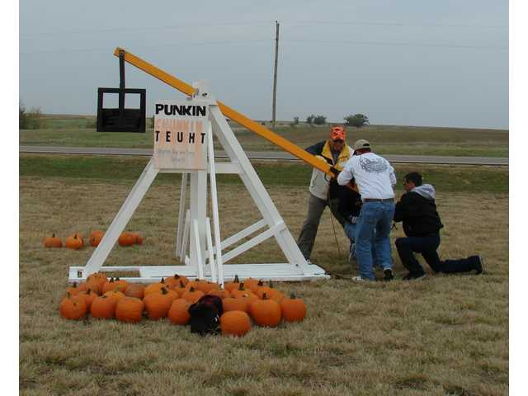
Punkin’ Chunkin’
  Example
  (handout)
Chunkin’ Video
http://science.discovery.com/tv-shows/punkin-chunkin/videos/behind-the-chunk.htm

Slide 14
Double Checking the Itinerary
  Examining the Standards
  Verbs
  Expectations
  Unpacking (http://maccss.ncdpi.wikispaces.net/)

Slide 15
Packing the Necessities
Name | Website
Shodor | http://www.shodor.org/
Turn on Common Core Math | http://www.turnonccmath.com/
Calculation Nation | http://calculationnation.com/
CCSS Math | http://ccssmath.org
Dynamic Software “Core Math Tools” | http://www.nctm.org/resources/coremathtools
Enriching Mathematics | http://nrich.maths.org/public/
Illustrative Mathematics | http://www.illustrativemathematics.org/standards/hs
Inside Mathematics | http://www.insidemathematics.org/index.php/tools-for-teachers
K-5 Math Teaching Resources | http://www.k-5mathteachingresources.com/
Mathalicious | http://www.mathalicious.com/
Mathematics Assessment Project | http://map.mathshell.org/materials/tasks.php
Mathematics Modeling Lesson Plans | http://www.indiana.edu/~iucme/mathmodeling/lessons.htm
Mathematics Blackline Masters (K-5) | http://lrt.ednet.ns.ca/PD/BLM/table_of_contents.htm http://wps.ablongman.com/ab_vandewalle_math_6/0,12312,3547876-,00.html http://www.ablongman.com/vandewalleseries/
National Council of Teachers of Mathematics | http://www.nctm.org/
National Council of Supervisors of Math | http://www.mathedleadership.org/
Number line created to your specifications | http://themathworksheetsite.com/numline.html
Ohio Resources | http://www.ohiorc.org/
Open Resources | http://davidwiley.org/
National Library of Virtual Manipulatives | http://nlvm.usu.edu/
NCTM Illuminations | http://illuminations.nctm.org/
Learn Zillion | http://learnzillion.com/
North Carolina Council of Teachers of Mathematics | http://www.ncctm.org/
Thanks to NC DPI for compiling this list of web resources

Slide 16
Looking Out for Intersections
How do the Standards Intersect with Standards in other content areas?
How do the Standards Intersect with the elements of CIA Planning?
Notes:
As we travel, we often look for better ways to get where we are going. The CC & ES provide us with many opportunities integrate the standards through a conceptual lens using CIA planning. As you work with the standards, you should always be on the look out for intersections and better travel routes.

Slide 17
Looking Out for Intersections
CIA Planning
  Conceptual Based
  Formulate Big Ideas around the Science and Social Studies Essential Standards
  Integrate ELA Standards with intent
  Take advantage of existing opportunities
Notes:
We may want to give just a few general reminders about CIA at this point. We will go more in depth during sessions 3 and 4.

Slide 19
Notes:
We may want to give just a few general reminders about CIA at this point. We will go more in depth during sessions 3 and 4.

Slide 20
Continuing the Journey
Between Session Work
Try one of the performance tasks we discussed or did today with a group of your students and bring your results and reflection to our next session.

Slide 21
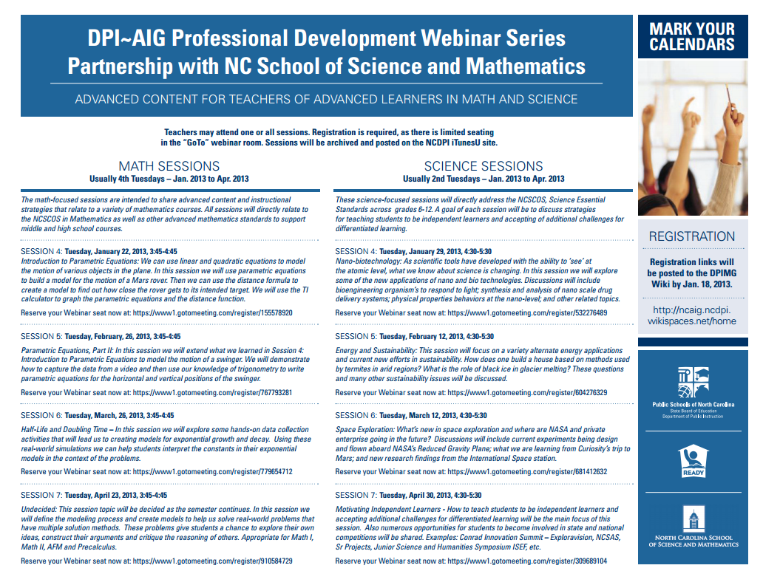
Continuing the Journey
Recordings of Previous Sessions

Slide 22
Continuing the Journey
Session Dates
April 9 – Resources and Strategies by content areas.
April 23 – Elements of CIA planning and the Standards
May 7 – CIA Planning: Putting it all together & integrating the standards

