Slide 1
Packing Tuesdays
Packing the Common Core
and Essential Standards
Tuesday, April 9, 2013
Hunters Creek Middle School
Michael Elder, Director Academic Innovation

Slide 2
Room Assignments
Subject Area | Room
K-5 English Language Arts | 105
6-8 and 9-12 English Language Arts | 107
K-12 Social Studies | 103
K-8 Science | 101
9-12 Science | 111
K-5 Math | 109
6-12 Math | 110
K-12 Fine Arts | 108
K-12 Health/PE | 112

Slide 3
The Layover
Between Session Work
Last time you were asked to:
Try one of the performance tasks we discussed or did today with a group of your students and bring your results and reflection to our next session.

Slide 4
To Insert
Interactive Notebook
Angry Birds and other activities
AIMS: Bank; what’s my line;
Foldables
Circles- discovering the value of pi
Using yarn around the circle (diameters)
Area of circle on grid paper; relationship to radius

Slide 5
Brains In Gear
Does this help?
Tray One: 27 cupcakes
Tray Two: 25 cupcakes
Tray Three: 18 cupcakes
Tray Four: 16 cupcakes
Tray Five: 14 cupcakes
Mathematics Teaching in the Middle School (NCTM) | February 2013 | page 326
Notes:
Tray One: 27 cupcakes
Tray Two: 25 cupcakes
Tray Three: 18 cupcakes
Tray Four: 16 cupcakes
Tray Five: 14 cupcakes

Slide 6
Traveling Alerts
Hot Topics
In our world of math, what are the burning questions or issues that we can discuss now or research for you?
Reminder…Math Blog @ www.onslowmath.blogspot.com
New Information: Honors Course Guides

Slide 7
Packing: Where are We Going?
Develop a deeper understanding of the Common Core and Essential Standards.
Examine and develop performance tasks based on the new standards.
Explore resources to support CC & ES Curriculum, Instruction, & Assessment planning and implementation.
Examine the elements of CIA planning and how they relate to the CC & ES
Deepen understanding of conceptual planning;
integrating the standards through CIA Planning

Slide 8
Where are We Going?
Outline for Packing Tuesdays
Session 1 – Standards and Performance Tasks by content areas.
Session 2 – (today) Resources and Strategies by content areas.
Session 3 – Elements of CIA planning and the Standards
Session 4 – CIA Planning: putting it all together & integrating the standards.

Slide 9
Today’s Leg of the Journey
Continue gathering and sharing ideas, resources, and strategies for Packing our Math Suitcase
Begin looking at CIA and Math Planning

Slide 10
Traveling Conditions
Group Discussion
Three Shifts (next slide)
How should/does Planning look different as a result of these shifts?
How should/does Instruction look different today as a result of these shifts?
How should/does Assessment look different today as a result of these shifts?
Notes:
When planning a trip, we typically look ahead, check the weather conditions, and then begin packing for our trip. So, let’s take a look at our current traveling conditions.

Slide 11
Mathematics-Common Core for State Standards
1. Focus strongly on the major work of the grade | Rather than racing to cover everything in today’s mile-wide, inch-deep curriculum, teachers use the power of the eraser and significantly narrow and deepen the way time and energy is spent in the math classroom. They focus deeply on only those concepts that are emphasized in the standards so that students can gain strong foundational conceptual understanding, a high degree of procedural skill and fluency, and the ability to apply the math they know to solve problems inside and outside the math classroom.
2. Coherence: think across grades, and link to major topics within grades | Thinking across grades: Instead of treating math in each grade as a series of disconnected topics, principals and teachers carefully connect the learning within and across grades so that, for example, fractions or multiplication develop across grade levels and students can build new understanding onto foundations built in previous years. Teachers can begin to count on deep conceptual understanding of core content and build on it. Each standard is not a new event, but an extension of previous learning. Linking to major topics: Instead of allowing less important topics to detract from the focus of the grade, these topics are taught in relation to the grade level focus. For example, data displays are not an end in themselves but are always presented along with grade-level word problems.
3. Rigor: require conceptual understanding, procedural skill and fluency, and application with intensity. | Conceptual understanding: Teachers teach more than “how to get the answer” and support students’ ability to access concepts from a number of perspectives so that students are able to see math as more than a set of mnemonics or discrete procedures. Students demonstrate deep conceptual understanding of core math concepts by solving short conceptual problems, applying math in new situations, and speaking about their understanding. Procedural skill and fluency. Students are expected to have speed and accuracy in calculation. Teachers structure class time and/or homework time for students to practice core functions such as multiplication facts so that students are able to understand and manipulate more complex concepts. Application: Students are expected to use math and choose the appropriate concept for application even when they are not prompted to do so. Teachers provide opportunities at all grade levels for students to apply math concepts in “real world” situations. Teachers in content areas outside of math, particularly science, ensure that students are using math – at all grade levels – to make meaning of and access content.

Slide 12
Performance Tasks
Constructed Response as a Performance Task
G.R.A.S.P.S. Method (handout)
http://opi.mt.gov/PDF/CurriculumGuides/Curriculum-Development-Guide/GRASP.pdf
http://grantwiggins.files.wordpress.com/2012/02/wiggins-mod-m-grasps-and-roles.pdf
www.mathunpacking.weebly.com or
http://www.ncpublicschools.org/effectiveness-model/measures/released-exams/
Notes:
When packing for a trip, we typically pack the necessities first. So, as we pack for the continued implementation of the CC & ES, it is necessary to have a deep knowledge and understanding of the standards.

Slide 13
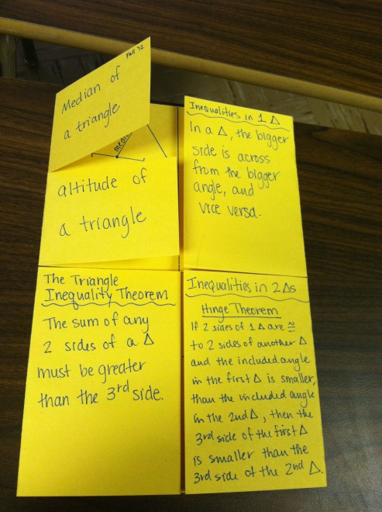
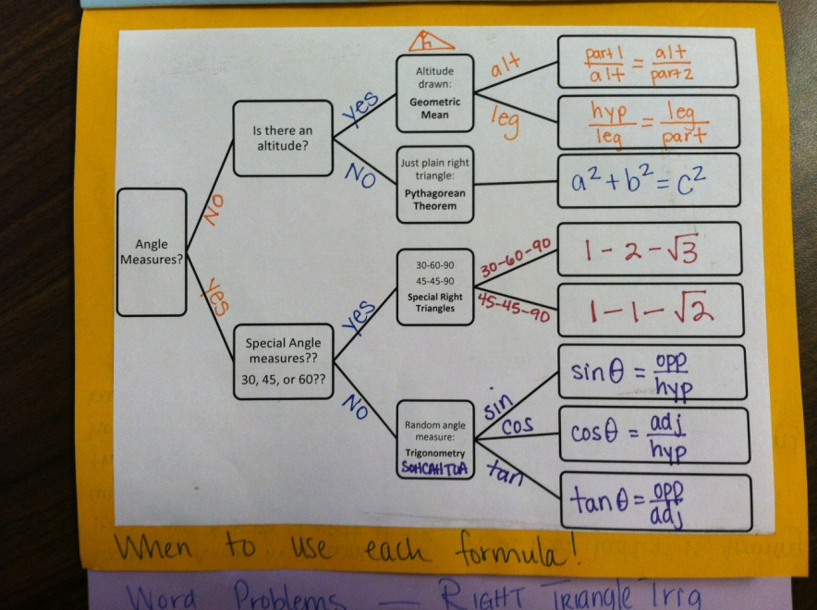
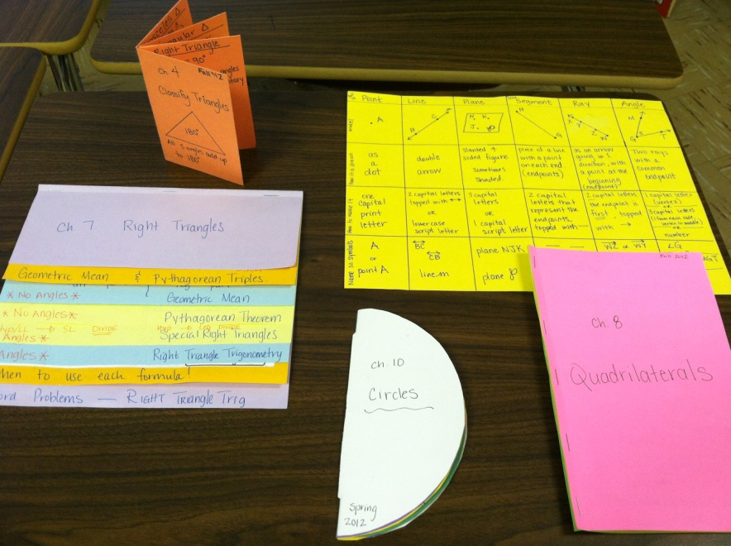
Connecting Flights
Language of Math- check it out...
http://www.dgelman.com/graphicorganizers/ Process Skills and planning

Slide 14
Outside your window…Illuminations for All Grades
Exploration Time
Last time we did performance tasks on paper and pencil…
Today, let’s use some time to explore Illuminations http://illuminations.nctm.org/

Slide 15
Packing the Necessities
Name | Website
Shodor | http://www.shodor.org/
Turn on Common Core Math | http://www.turnonccmath.com/
Calculation Nation | http://calculationnation.com/
CCSS Math | http://ccssmath.org
Dynamic Software “Core Math Tools” | http://www.nctm.org/resources/coremathtools
Enriching Mathematics | http://nrich.maths.org/public/
Illustrative Mathematics | http://www.illustrativemathematics.org/standards/hs
Inside Mathematics | http://www.insidemathematics.org/index.php/tools-for-teachers
K-5 Math Teaching Resources | http://www.k-5mathteachingresources.com/
Mathalicious | http://www.mathalicious.com/
Mathematics Assessment Project | http://map.mathshell.org/materials/tasks.php
Mathematics Modeling Lesson Plans | http://www.indiana.edu/~iucme/mathmodeling/lessons.htm
Mathematics Blackline Masters (K-5) | http://lrt.ednet.ns.ca/PD/BLM/table_of_contents.htm http://wps.ablongman.com/ab_vandewalle_math_6/0,12312,3547876-,00.html http://www.ablongman.com/vandewalleseries/
National Council of Teachers of Mathematics | http://www.nctm.org/
National Council of Supervisors of Math | http://www.mathedleadership.org/
Number line created to your specifications | http://themathworksheetsite.com/numline.html
Ohio Resources | http://www.ohiorc.org/
Open Resources | http://davidwiley.org/
National Library of Virtual Manipulatives | http://nlvm.usu.edu/
NCTM Illuminations | http://illuminations.nctm.org/
Learn Zillion | http://learnzillion.com/
North Carolina Council of Teachers of Mathematics | http://www.ncctm.org/
Thanks to NC DPI for compiling this list of web resources

Slide 16
Geometer’s Sketchpad???
Anyone, Bueller…
Just checking…

Slide 17
Making the Next Flight
What in the Curriculum, Instruction, and Assessment (CIA) planning process is the most challenging for you as a math teacher?

Slide 18
Continuing the Journey
April 23 – Elements of CIA planning and the Standards
May 7 – CIA Planning: Putting it all together & integrating the standards
Summer Math Symposium: Jacksonville High School
June 17-20
Onslow County Summer Institute
Northside High School
August 12-14

Slide 19
Last Minute Reminder…
Where in the world do I find…
Most Important Sites
http://maccss.ncdpi.wikispaces.net/
http://mathunpacking.weebly.com
http://onslowmath.blogspot.com/
Notes:
When packing for a trip, we typically pack the necessities first. So, as we pack for the continued implementation of the CC & ES, it is necessary to have a deep knowledge and understanding of the standards.

Slide 20
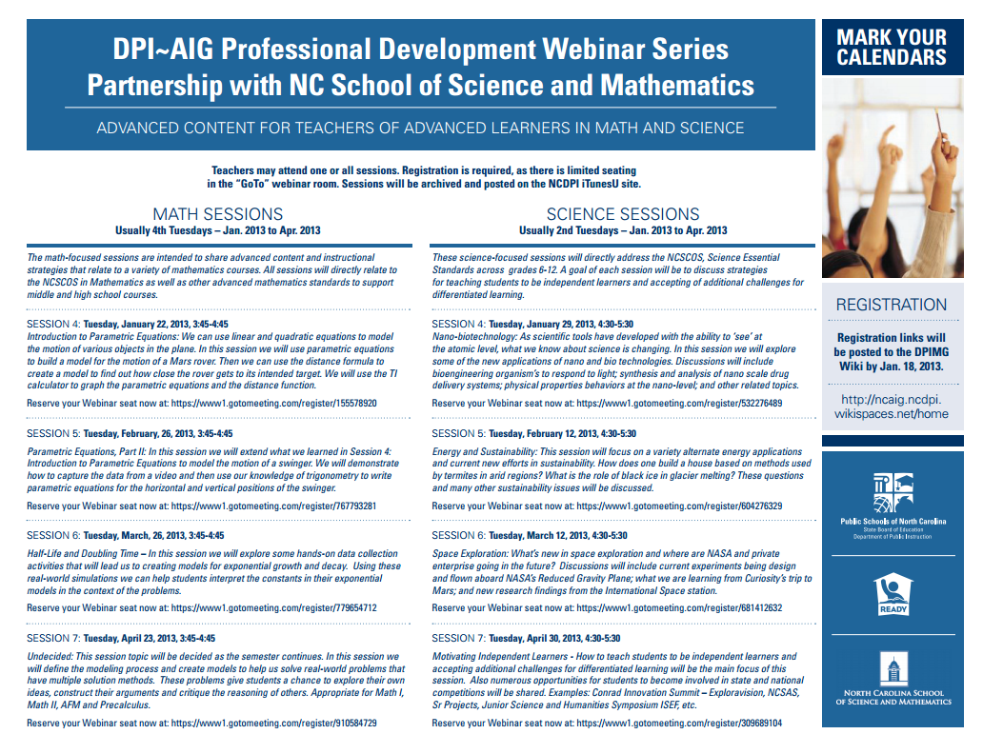
Just a Reminder
Recordings of Previous Sessions

