Slide 1
Setting Sail with New Math Standards
Shelly Alford, Stateside Elementary
Michael Elder, Academic Innovation
July 31-August 2, 2012

Slide 2
Follow Along?
Go to www.join.me/_____ (enter the code here)
A tool if you do not have a projector
Great for 1:1 classrooms
Can switch control
Could be a student presenter as well

Slide 3
Share your Expertise
Go to www.todaysmeet.com/mathresources
Enter your thoughts and resources
Please share all the great websites, people’s names, text resources, etc
We’ll add the results to the presentation at the end

Slide 4
Agenda
Where we have been
Common Core
Timeline for Change
Assessment
Revised Bloom’s Taxonomy
NC DPI Resources Run Through
Resource Exploration Time
Staying Connected
NC DPI List Serve
One another
Reflection

Slide 5
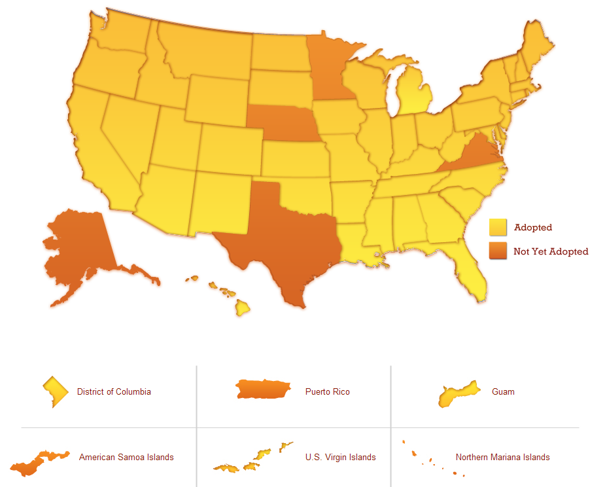
Common Core Adoption

Slide 6
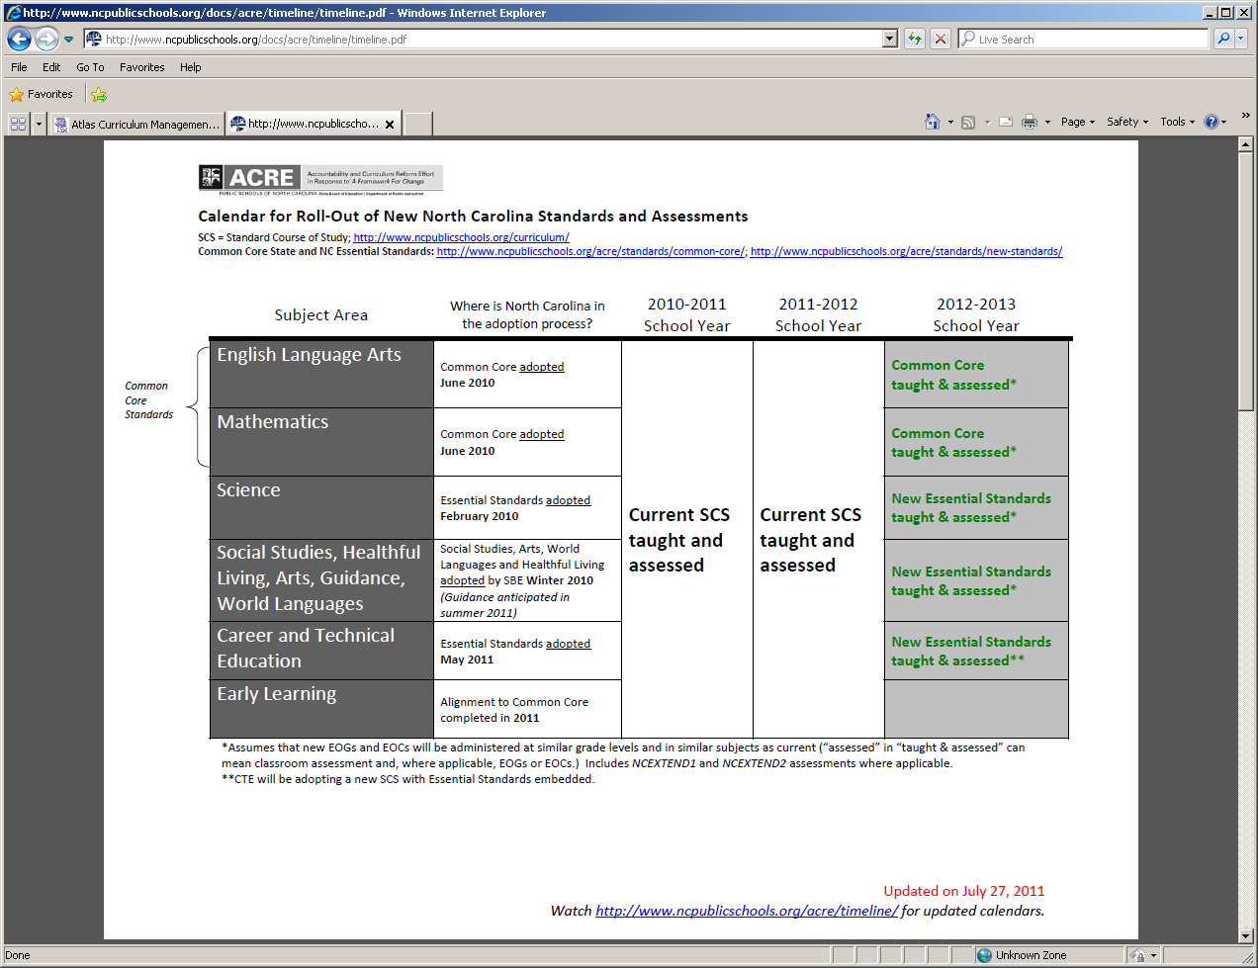
Timeline for Change

Slide 7
Assessment
Elementary and Middle Grades | Reading | Math | Science | Social Studies | Other
Grade 3 | EOG | EOG
Grade 4 | EOG | EOG
Grade 5 | EOG | EOG | EOG
Grade 6 | EOG | EOG
Grade 7 | EOG | EOG
Grade 8 | EOG | EOG | EOG
The 2012-2014 Summative EOG Assessments will be developed by NC
The 2014-2015 Summative Assessment for Reading and Math will be developed by the Smarter Balanced Educational Consortium
Summative Assessments for Science (Grades 5 &8 developed by NC)

Slide 8
MSLs (Measures of Student Learning)
Phase 1: Spring 2013
Grade 3 | Grade 4 | Grade 5
Science | Science | (No MSL due to EOG)
Social Studies | Social Studies | Social Studies
Phase 2: Spring 2014
Healthful Living
Health Education Grades 3–8
Physical Education Grades 3–8
Phase 3: Spring 2014-2015
More Information to Come

Slide 10
K-5 Math Vocabulary

Slide 11
Do you Symbaloo?
www.symbaloo.com
Visual Bookmarks
Great for adults
Great for Student Projects
Resource Lists
Bibliographies
Great for Parents

Slide 12
NC DPI Common Core Resources in Symbaloo

Slide 13
NC DPI Quiz Show How would I find information to answer…
Question: What do I need to teach?
Unpacking Documents
Question: Where did this Standard come from (or go to)?
Crosswalk Documents
Question: What do I want to take home with me when I plan?
Standards One-Pagers
Question: What can I give my students for enrichment, acceleration, or challenge?
Math Stars and Math SuperStars
Question: What terms are essential?
Math Glossary
Question: Are there any examples of how to teach math in this way?
NC DPI Activities/Units

Slide 14
Activity Time
Tens Frames
Hands on Equations
DPI “Units”
Exploration Stations

Slide 15
NC DPI Units / Activities
Review a unit for a grade level you are comfortable with
Record your thoughts at www.moourl.com/dpiunit
I would use this | I would not use this part | Materials I would need | Something I would add | Other Comments

Slide 16
Reminders
Math is not in the manipulative
Manipulatives make the math tangible
Manipulatives make the math accessible
Manipulatives do not make the math “easier”
Manipulatives are not only for struggling students
Manipulatives do not mean you are slow
Manipulatives are necessary for gifted students

Slide 17
Let’s Rewind a Bit
One-pagers of Standards
Critical Areas
Math Practices
Verbs & Assessments

Slide 18
Assessment Resources
K-2 Assessment
3-5 Assessment
2012-2014→ NC developed
Released Items late fall or late first semester
2014→ www.smarterbalanced.org

Slide 19
Staying Connected
Shelly Alford (michelle.alford@onslow.k12.nc.us)
Michael Elder (michael.elder@onslow.k12.nc.us)
Extension 20264

Slide 20
NC DPI Listserv
Teachers can join the listserv of their choice by doing the following:
1. Send an email to the Listserv of your corresponding grade level by cutting and pasting the following address into the "To" box within your email application. The options are: join-k-5_math@lists.dpi.state.nc.us[Elementary requests] join-msmathdpi@lists.dpi.state.nc.us [Middle Grades requests] join-hsmathdpi@lists.dpi.state.nc.us [Secondary requests]
2. Leave the subject line and the body of the message blank.
3. Once successfully subscribed, a confirmation email will be sent.

Slide 21
Reflection
Tricider.com
http://tricider.com/multiBrainstorming/Bqsj
Where are we?
What do you need?
How can we help?
Who else can help?
How can you help?
In closing http://www.youtube.com/watch?v=E91gAjunqOM

