Slide 1
Assessing Math Concepts
Math Vetting
Onslow County Schools
October 15, 2013

Slide 2
Why AMC?
Article (Handout):
Too Easy for Kindergarten, Just Right for First Grade (Kathy Richardson, NCTM, April 1997
Research repeated through 2013)
How Children Learn Number Concepts
“The Red Book”
Heart of Number Sense
Assessment and Instruction

Slide 3
Anne McManus, Didax
Overview

Slide 4
Research
Students are shown this number. Teacher points to the 6 and says, “Can you show me this many?”
16
Notes:
Constance Kamii has done extensive research on how young children learn mathematics. Here is a task frequently used to assess understanding of tens and ones. Students usually are successful, and count our 6 blocks.

Slide 5
Research
When the teacher points to the 1 in the tens place and asks,
“Can you show me this many?”
16
Notes:
Kamii found that essentially no first graders could correctly complete this task.

Slide 6
Research
By third grade nearly half the students still do not ‘get’ this concept of place value..
16
Notes:
Many 3-5 graders still do not give the correct answer.

Slide 7
More research - It gets worse!
A number contains 18 tens,
2 hundreds, and 4 ones.
What is that number?
1824
Notes:
Grayson Wheatly’s research with 5,000 middle schoolers were given the following task:This task was posed to 5,000 5-8 graders.
Some students gave this answer. Others knew the tens had to be in the middle, so…..
Many gave this answer, knowing about decimals, and that you could only have 3 digits if a number was in the hundreds.
Around 50% of the middle school students gave the correct answer.

Slide 8
More research - It gets worse!
A number contains 18 tens,
2 hundreds, and 4 ones.
What is that number?
1824
2184
Notes:
Grayson Wheatly’s research with 5,000 middle schoolers were given the following task:This task was posed to 5,000 5-8 graders.
Some students gave this answer. Others knew the tens had to be in the middle, so…..
Many gave this answer, knowing about decimals, and that you could only have 3 digits if a number was in the hundreds.
Around 50% of the middle school students gave the correct answer.

Slide 9
More research - It gets worse!
A number contains 18 tens,
2 hundreds, and 4 ones.
What is that number?
1824
2184
218.4
Notes:
Grayson Wheatly’s research with 5,000 middle schoolers were given the following task:This task was posed to 5,000 5-8 graders.
Some students gave this answer. Others knew the tens had to be in the middle, so…..
Many gave this answer, knowing about decimals, and that you could only have 3 digits if a number was in the hundreds.
Around 50% of the middle school students gave the correct answer.

Slide 10
More research - It gets worse!
A number contains 18 tens,
2 hundreds, and 4 ones.
What is that number?
1824
2184
218.4
384
Notes:
Grayson Wheatly’s research with 5,000 middle schoolers were given the following task:This task was posed to 5,000 5-8 graders.
Some students gave this answer. Others knew the tens had to be in the middle, so…..
Many gave this answer, knowing about decimals, and that you could only have 3 digits if a number was in the hundreds.
Around 50% of the middle school students gave the correct answer.

Slide 11
So, what’s so hard about K-2 math?

Slide 12
LET’S COUNT
e, f, g, h, i
Notes:
It is essential for you to connect the numeral with the quantity, not the numbers you are familiar with.

Slide 13
Let’s Do Some Math
e + e = ____
f + g = ____
i + e = ____

Slide 14
Next…
What is f less than i ?
If f + f is h, what is f + g?
Let’s skip count by f starting at h.

Slide 15
And now..
If you have m friends over, will k ice cream sandwiches be enough?
Which is more, j + j, or i + l ?

Slide 16
How are you feeling?

Slide 17
ALGEBRA
In the words of Marilyn Burns,
“Algebra is a generalization of arithmetic.”

Slide 18
AMC: What should they know?
The Critical Learning Phases

Slide 19
Critical Learning Phases for Numbers to 100
Counting and Comparing
1. Counting Objects
2. Changing Numbers
Number Composition and Decomposition to 10
4. Number Arrangements
5. Combination Trains
Place Value: Numbers as Tens and Ones
7. Ten Frames
9. Two-Digit Addition and Subtraction
6. Hiding
8. Grouping Tens
3. More/Less Trains

Slide 20
How will we know where they are and what to do to help?
AMC Anywhere

Slide 21
When planning ask…
“What task can I give to build understanding?”
Rather than
“How can I explain clearly so they will understand?”
Grayson Wheatley, NCCTM, 2004

Slide 22
The Assessments
  Inform instruction
  Document growth
  Uncover the child’s edge of understanding
  Guide us as to what is coming into view as children construct mathematical understandings
                http://www.assessingmathconcepts.com/amc_assessments.html

Slide 23
The assessments are not about “helping children be right,” but about uncovering what they need regarding instruction.
                http://www.assessingmathconcepts.com/amc_assessments.html
Notes:
In this slide, it is important to note that “The more we try to fix the students so that the mistakes were hidden, we learn less about the child. (Kathy Richardson quote)

Slide 24
Big Picture Overview
This is what a student knows
or This is where a student is struggling
This is what a student understands incorrectly
Here is how to help the student

Slide 25
Number Composition and Decomposition
Combination
Trains
Hiding
Assessment

Slide 26
Video
Evan- Second Grader
Hiding Assessment (Final Number Composition and Decomposition to 10)
You think you know, but do you know?
Begin at 5:19 (parts of 10) through 8:00
(at 6:34 shifts to taking away)

Slide 27
Critical Learning Phases for Numbers to 100
Counting and Comparing
1. Counting Objects
2. Changing Numbers
Number Composition and Decomposition to 10
4. Number Arrangements
5. Combination Trains
Place Value: Numbers as Tens and Ones
7. Ten Frames
9. Two-Digit Addition and Subtraction
6. Hiding
8. Grouping Tens
3. More/Less Trains

Slide 28
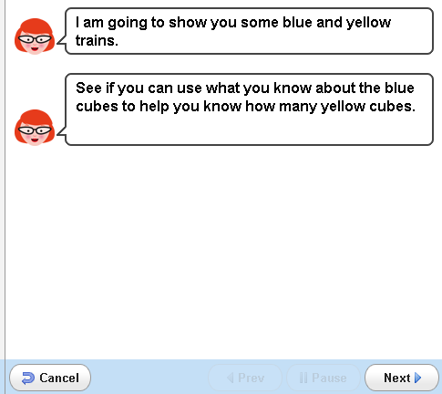
Sample Assessment
Combination Trains

Slide 29
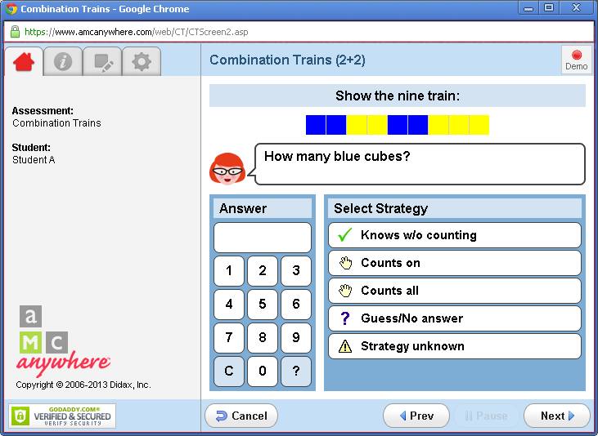

Slide 30
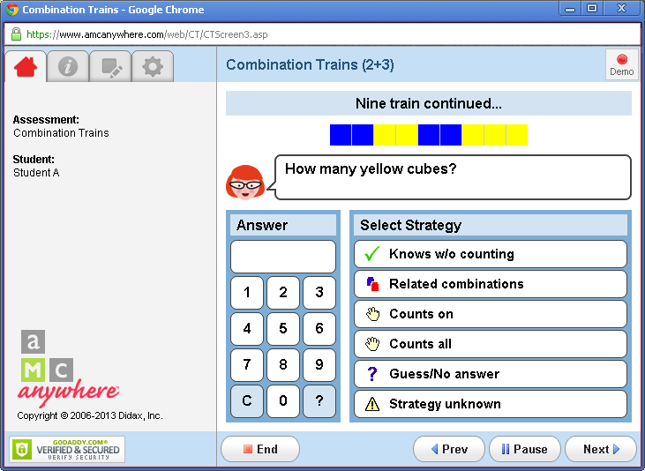

Slide 31
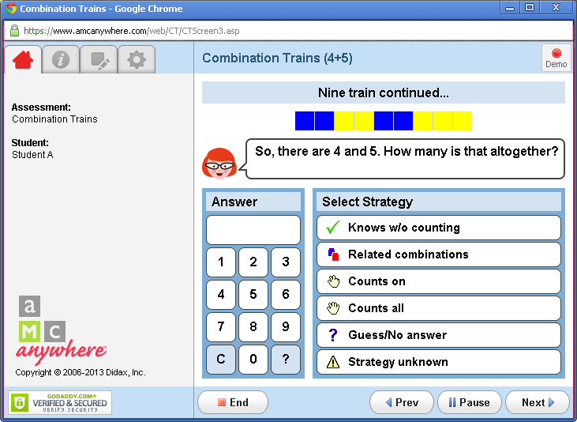

Slide 32
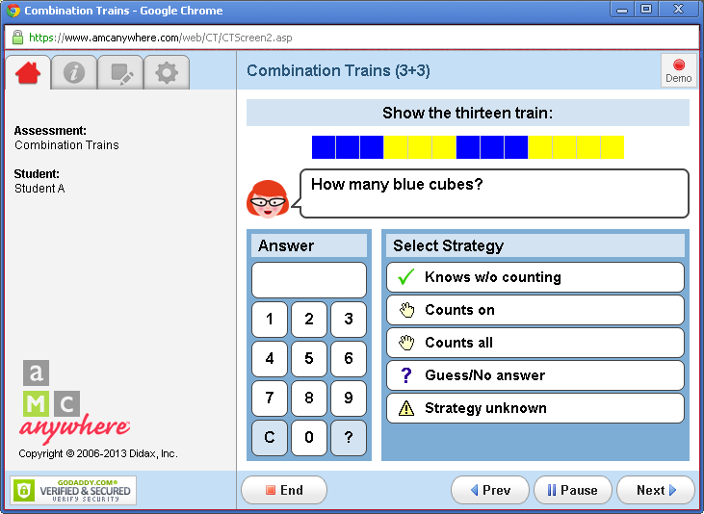

Slide 33
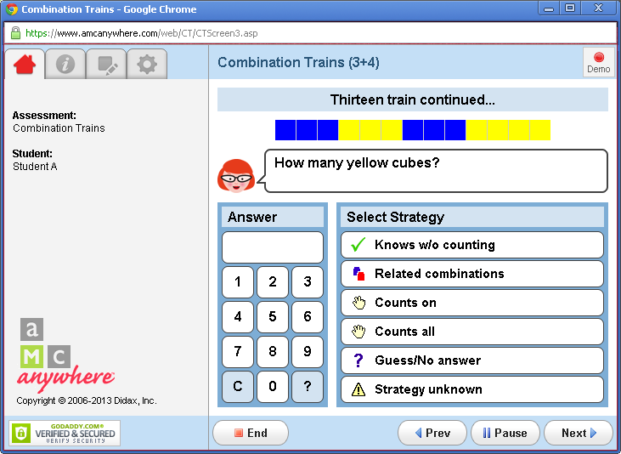

Slide 34
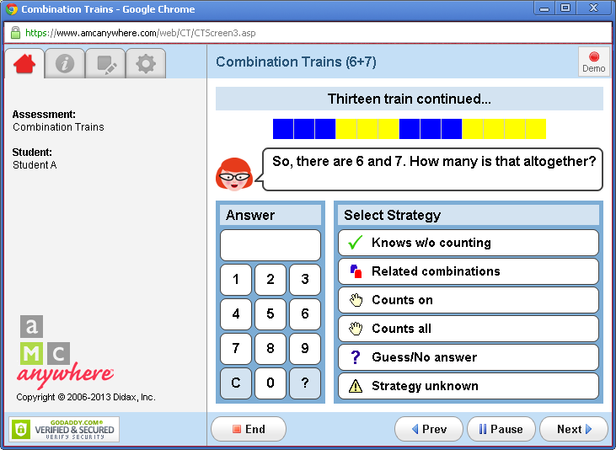

Slide 35
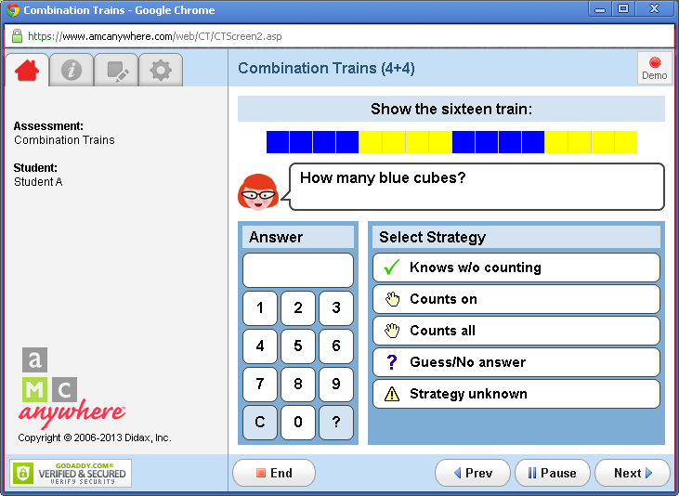

Slide 36
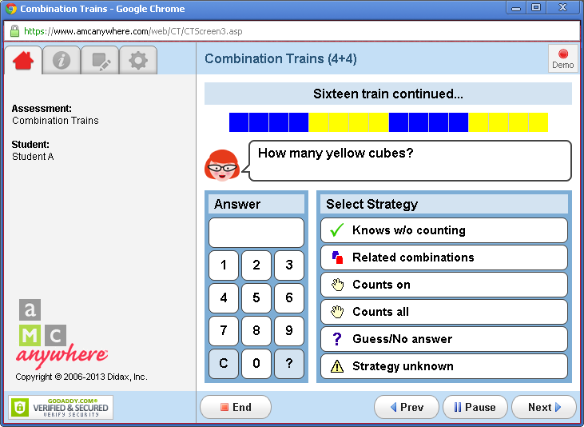

Slide 37
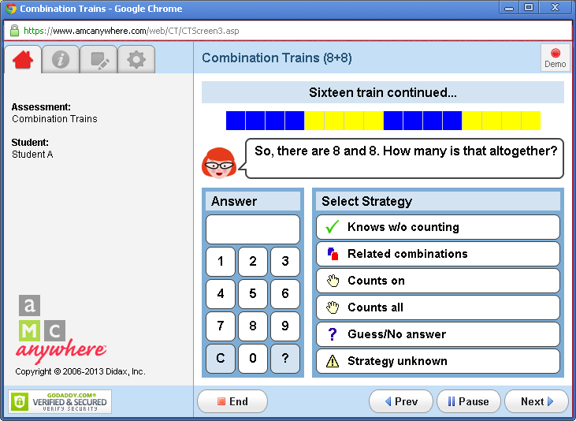

Slide 38
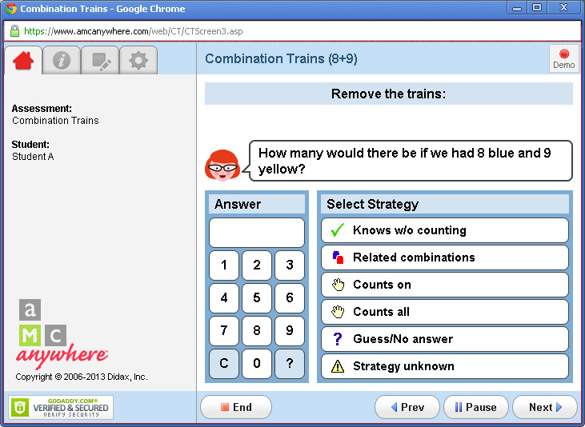

Slide 39
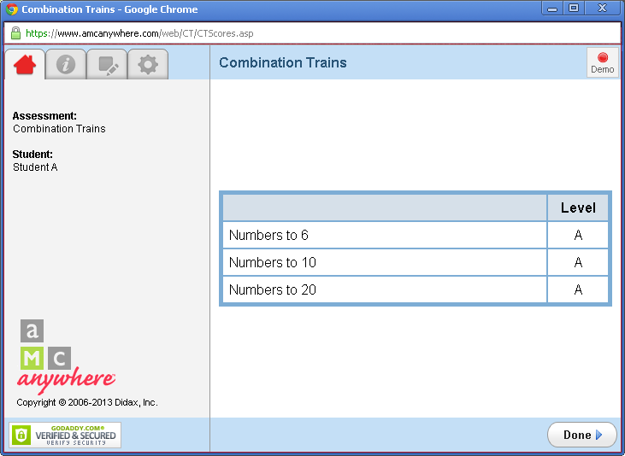
Results

Slide 40
You can practice with the
AMC Anywhere assessments online
(we will need a demo login)
www.amcanywhere.com
Notes:
At this time, you will help teachers log onto their AMC Anywhere accounts and spend a small amount of time practicing the counting assessment. You can replay the video or you can allow teachers to practice with one another. Please remind teachers that the most important piece is to have materials, including cubes that are all the same color ready as well as any numbers or other cards that you may need. One suggestion is to have labeled bags with each assessment so that you can pick up the counting assessment bag knowing that you have all of the materials. Tell teachers that you are spending a few minutes on the counting assessment, but you will spend more time on the three assessments that they will use within their classrooms.

Slide 41
What is the Goal?
To determine what number combinations the student knows and to find out if they can use the answer to a combination they know to figure out one they don't know.
Note that each train includes two relatively easy combinations and one relatively harder combination. The students will either know the combination without counting or they will need to count on or count all.

Slide 42
Combination Trains Assessment
Critical Learning Phases
Combines parts by using relationships
Knows doubles
Uses doubles plus one
Uses doubles minus one
Combines parts by knowing

Slide 43
Assessment Results
Summarized at end of assessment as:
  A – Ready to Apply
  P – Needs Practice
  I – Needs Instruction
  N – Needs Prerequisite
  Complete descriptions included in Assessing Math Concepts 2012 Edition – refer to pp. 16-19 and pp. 26 – 31.

Slide 44
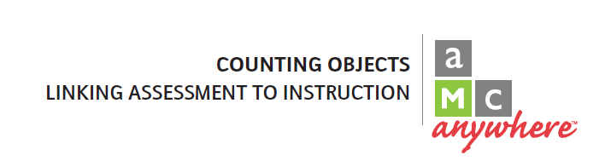
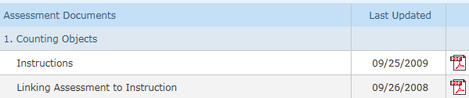
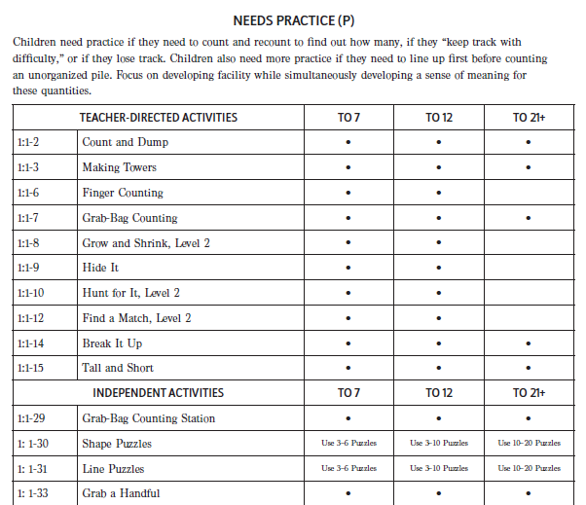
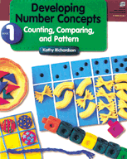
Use “Linking Assessment to Instruction” guides for instructional support from Developing Number Concepts
Select Resources
Select Linking Assessment to Instruction

Slide 45
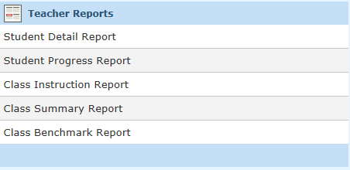
Interpreting & Using Assessment Results
  Use AMC Anywhere reporting to view student results.
Select Reports
Select from a variety
of reports.
Notes:
Once you have completed the assessment, you can view results by selecting the report tab on amcanywhere.com.
From this tab there is a variety of assessment results to view.
Student Detail Report: Provides information on a specific student for each assessment completed. Only one assessment can be viewed at a time. This report is where you can add notes after completing the assessment.
Student Progress Report: Provides a summary of the results from all the dates the assessment was completed.
Class Instruction Report: Gives data on all students for a specific assessment. This report can be used to place students in groups according to level of understanding.
Talk at your table. How could you use this information?
Class Summary Report: Is very similar to the class instruction report. This assessment is often used to identify students level of understanding to place in groups with students of like understanding.
Class Summary Report:

Slide 46
“Both the assessments and instruction should leave you with a question. It gives you something to watch for.”
-Kathy Richardson

Slide 47
Example Tasks: Combination Trains
Handout
  Combination Trains:
  Linking Assessment to Instruction
Handout
  If a student is struggling with this try these stations

Slide 48
Combination Trains
Needs Prerequisite (N)
Focus- Recognizing small groups of objects. Begin with numbers that are small enough for them to recognize the groups without counting.
Teacher Directed Activities |  | To 6 | To 10 | To 20
1:1-13 | Tell Me Fast | Yes | Yes
1:1-10 | Hunt for It | Yes | Yes
1:1-9 | Hide It | Yes | Yes
1:1-12 | Find a Match | Yes | Yes
2:3-2 | Instant Recognition of Number Arrangements | Yes | Yes | Yes
2:3-3 | Instant Recognition of Number Shapes | Yes | Yes | Yes
2:3-4 | Instant Recognition of Number Trains | Yes | Yes | Yes
2:3-3 and 2:3-33 | Instant Recognition of Number Shapes Combined with Number Shape Pairs |  |  | Yes

Slide 49
Combination Trains
Needs Instruction (I)
Focus- Describing the parts of numbers to help the children move from counting all to combining parts.
Teacher Directed Activities |  | To 6 | To 10 | To 20
2:2-1 | Snap It, Level 1 and Extension | Yes | Yes
2:2-2 | The Tub Game, Level 1 and Extension | Yes | Yes
2:2-3 | The Wall Game | Yes | Yes
2:2-4 | Bulldozer | Yes | Yes
2:2-5 | The Cave Game | Yes | Yes | Yes
2:2-9 | Number Shapes: On and Off | Yes | Yes
2:2-11 | Number Trains: On and Off | Yes | Yes
2:2-7 | Finger Combinations | Yes | Yes
2:3-1 | Combining Stacks: Pick it Up | Yes | Yes | Yes
2:3-4 | Instant Recognition of Number Trains | Yes | Yes
2:3-3 | Instant Recognition of Number Shapes | Yes | Yes

Slide 50
Combination Trains
Needs Instruction (I)
Focus- Describing the parts of numbers to help the children move from counting all to combining parts.
Independent Activities *** |  | To 6 | To 10 | To 20
2:2-18 | Counting Boards: Making Up Number Combination Stories | Yes | Yes
2:3-24 | The Tub-Game Station | Yes | Yes
2:3-25 | The Snap It Station | Yes | Yes
2:3-18 | What Numbers Can You Make | Yes | Yes | Yes
2:3-17 | Describing Shape Puzzles | Yes | Yes | Yes

Slide 51
Combination Trains
Needs Practice (P)
Focus- Developing an awareness of the combinations they know. Predicting how many they think the total will be. Begin with numbers that are small enough for them to see that they can tell how many altogether without counting.
Teacher Directed Activities |  | To 6 | To 10 | To 20
2:2-9 | Number Shapes: On and Off | Yes | Yes
2:2-11 | Number Trains: On and Off | Yes | Yes
2:3-1 | Combining Stacks: Pick It Up | Yes | Yes | Yes
2:3-5 | Related Combinations: Short Stacks | Yes | Yes | Yes
2:3-28 | Related Combinations: Tall Stacks | Yes | Yes | Yes
2:3-29 | How Do You See It? Adding Number Shapes |  |  | Yes
2:3-4 | Instant Recognition of Number Trains | Yes | Yes
2:3-3 | Instant Recognition of Number Shapes | Yes | Yes
2:3-3 and 2:3-33 Instant Recognition of Number Shapes & Number Shape Pairs |  |  |  | Yes

Slide 52
Combination Trains
Needs Practice (P)
Focus- Developing an awareness of the combinations they know. Predicting how many they think the total will be. Begin with numbers that are small enough for them to see that they can tell how many altogether without counting.
Independent Activities *** |  | To 6 | To 10 | To 20
2:2-20 | Number Shapes: Using Number Cubes | Yes | Yes
2:2-21 | Number Shapes: Using Spinners | Yes | Yes
2:2-23 | Number Trains: Using Number Cubes | Yes | Yes
2:2-24 | Number Trains: Using Spinners | Yes | Yes
2:2-25 | How Many Ways | Yes | Yes
2:2-26 | Number Train Graph | Yes | Yes
2:3-14 | Combination Toss | Yes | Yes
2:3-17 | Describing Shape Puzzles | Yes | Yes | Yes
2:3-18 | What Numbers Can You Make | Yes | Yes | Yes
2:3-21 | Grab Bag Addition Station | Yes | Yes | Yes
3:3-36 | Roll and Double

Slide 53
Combination Trains
Ready to Apply (A)
Remember
  A child may be ready to apply for numbers to 6, but not for numbers to 10 or 20

Slide 54
WHAT’S AN INTERVIEW?
Choose a partner, one to be the reporter, one to be Edison.
What is the purpose of an interview?
Notes:
Edison, you don’t have to give correct information. Interviewer, you accept answers as if true. Don’t play.
Set the stage..big prize for the best story.

Slide 55
Anne McManus
Reporting Features

Slide 56
Our Contact Information:
Michael Elder (michael.elder@onslow.k12.nc.us)
Extension 20264
Anne McManus
(978)-877-1227
amcmanus@didax.com
www.didax.com

Slide 57
Assessing Math Concepts Sites
Math Perspectives:
http://mathperspectives.com/
Didax
http://www.didax.com/KathyRichardson/
Assessment Online Login
https://www.amcanywhere.com/

